Slide 1
Design
Sequence Diagram
Determine the order in which classes are accessed
Activity Diagram
Show all possible paths the user can take
Design Pattern
Iterator

Slide 2
Design Patterns
Iterator
Multiple Drink classes stored in maps
Normally input the key to access values
Can access key for each mapped drink
Allows for moving through maps without knowing key
Makes comparisons much easier

Slide 3
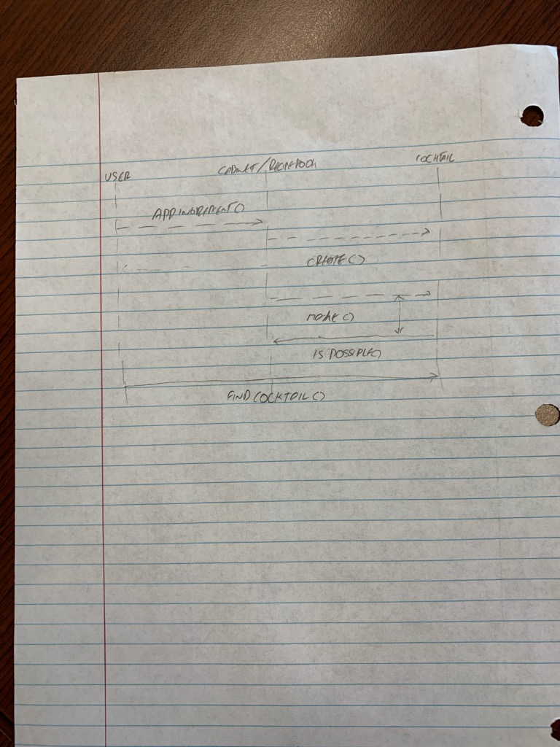
Sequence Diagram
The original diagram for our program.
Later realized that this may not accurately reflect the current state of the program.

Slide 4
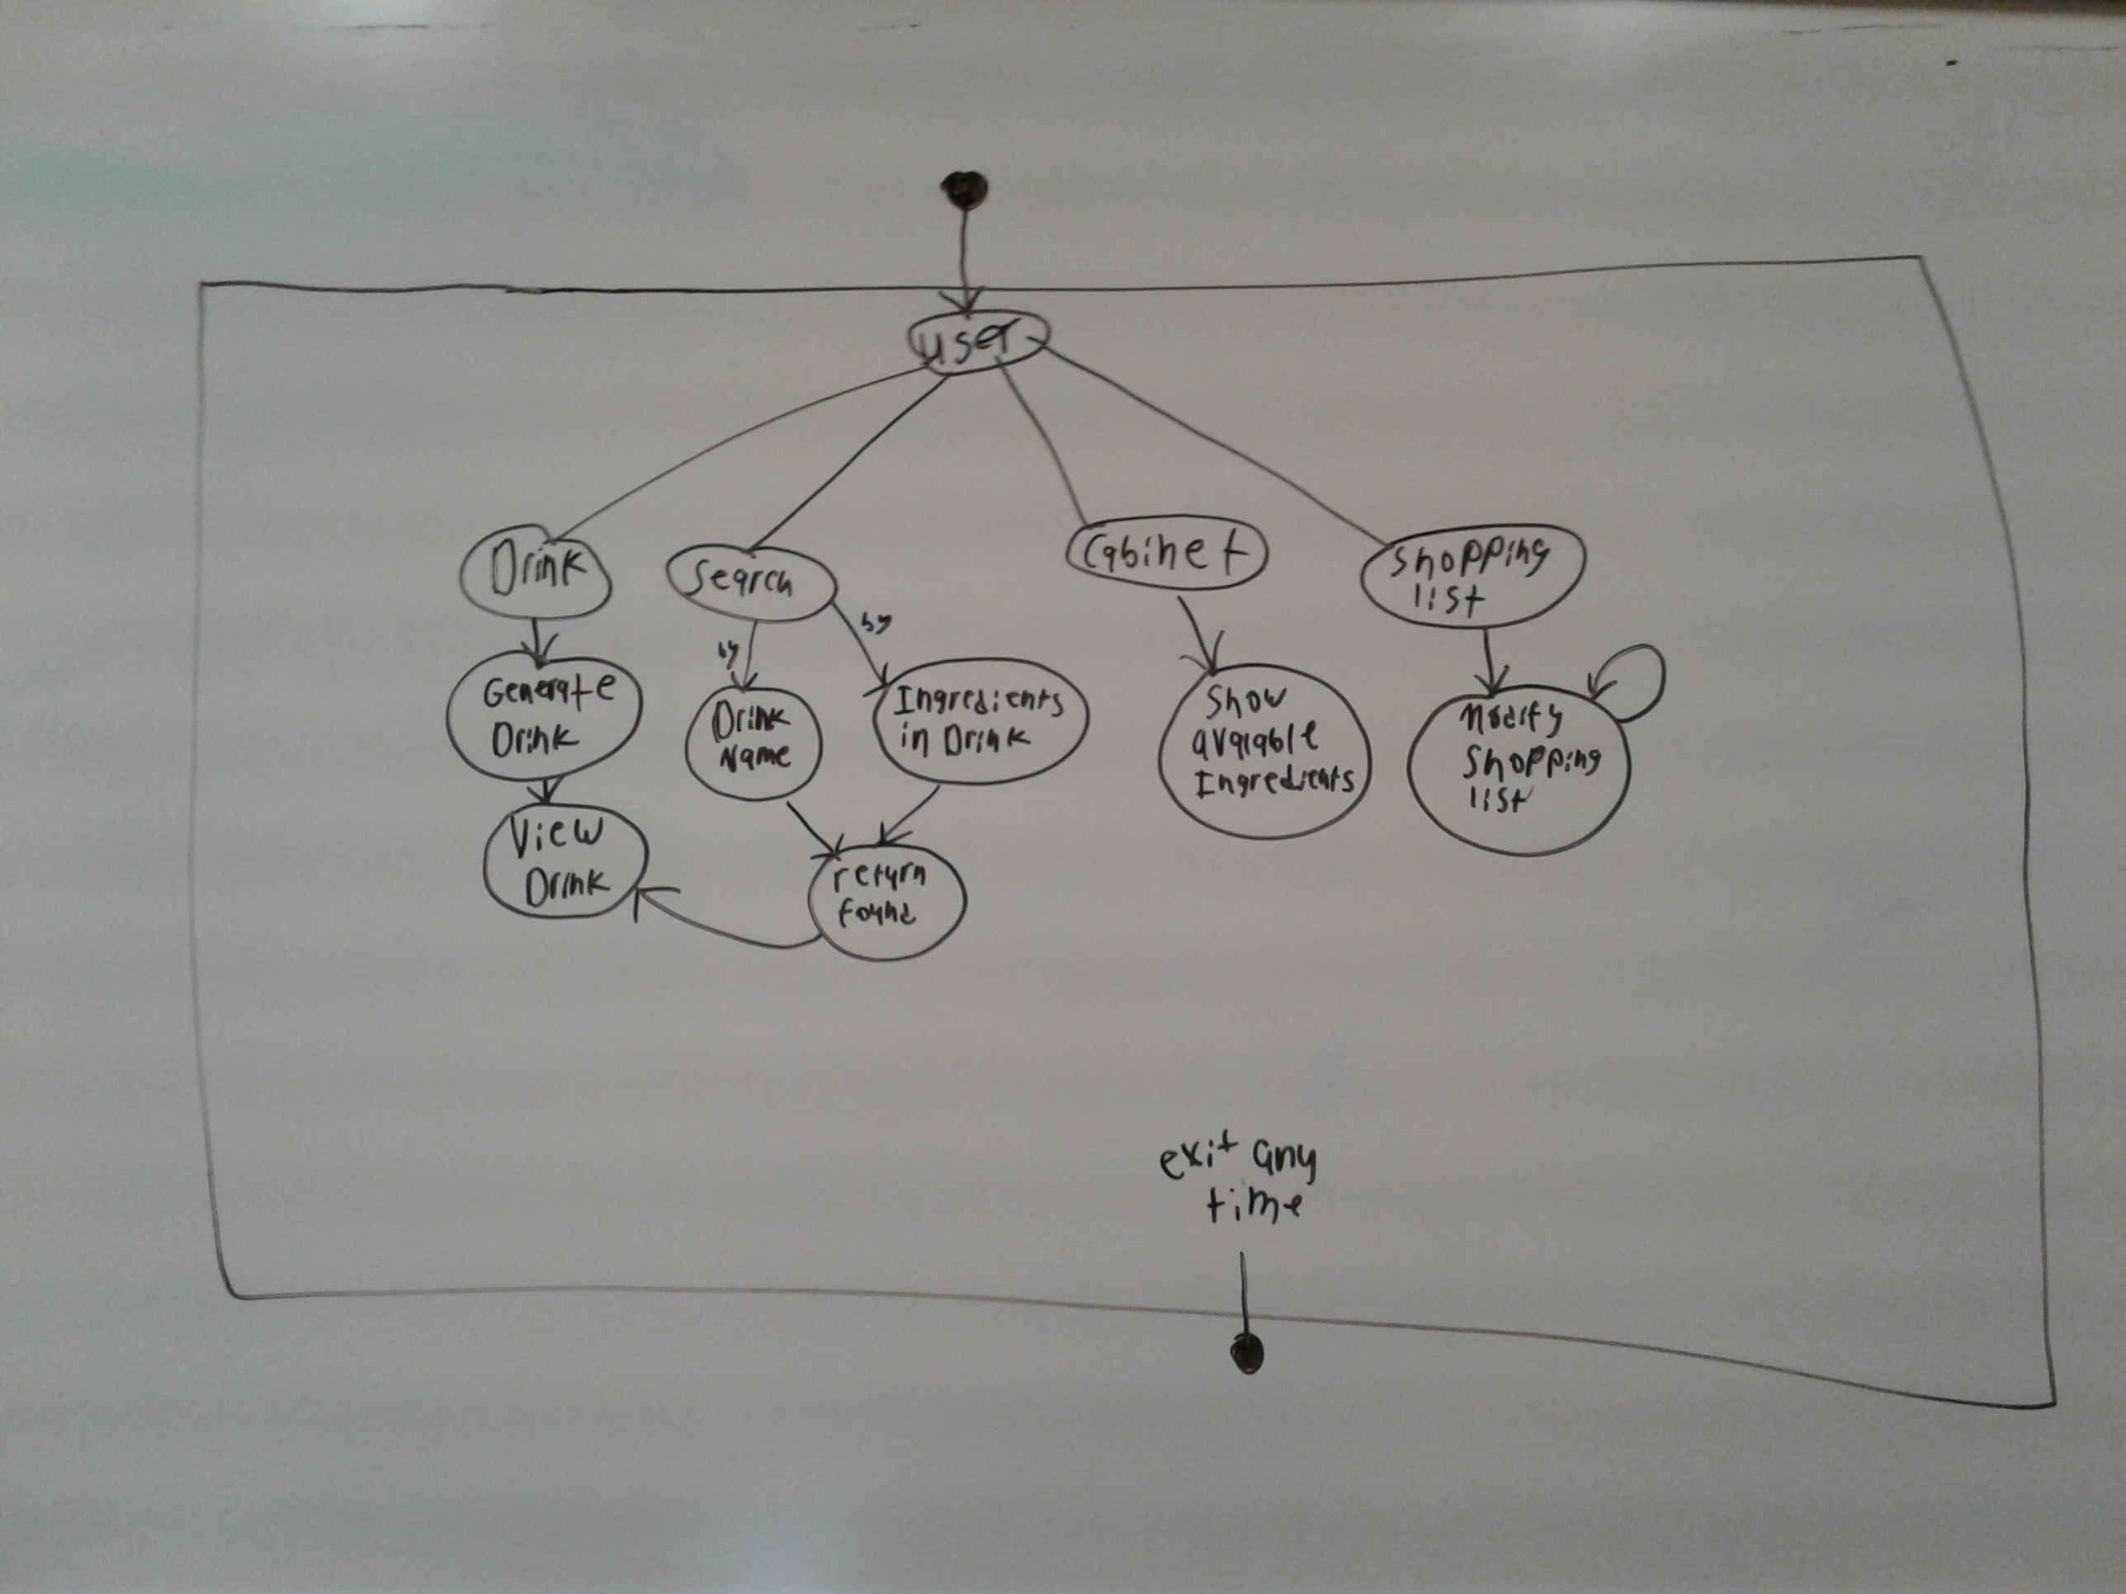
Activity Diagram
More accurately shows the current state of the program
Goes through the different paths in which you can use the program

Slide 5
Implementation - Search
Will take a string from the user
The class will search by drink name, drink ingredients or both
Separate functions for each
Uses Iterators to go through the map without knowing the keys
Can match partial names (“Da” will match with Daiquiri or Dark & Stormy)
Saves any drink in a separate map to return multiple values
Friends with Recipe to allow for easy access to Ingredients

Slide 6
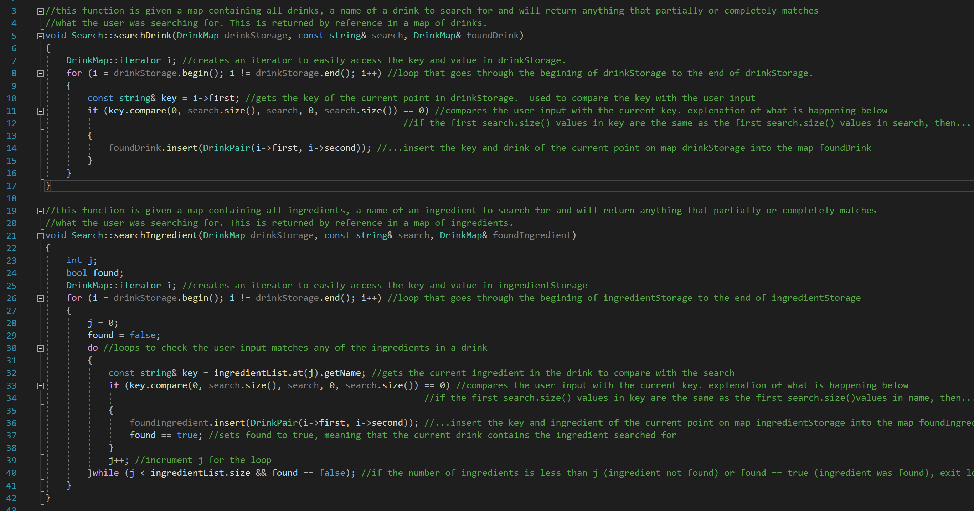
Implementation - Search

Slide 7
Test Plan
Test each button and confirm each output is correct
Pull up a random drink
Pull up favorites list
Check if shopping list works properly
Check ingredients in cabinet
Search for recipes based on drink name/ingredients
Display a found drink

